Slide 1

Name : Dimple Sri Sivani
College Name : Dhanekula Institute of Engineering and Technology
Branch : ECE
Roll : 228T5A0434
Email ID : yanagantisivani@gmail.com

Slide 2
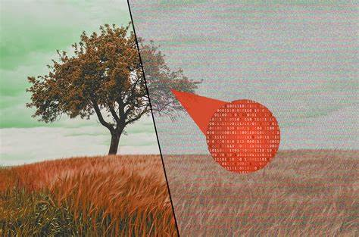
PROJECT TITLE/Problem Statement
HIDING TEXT INSIDE AN IMAGE USING STEGANOGRAPHY

Slide 3
AGENDA
Steganography is the hiding of a secret message within an ordinary message and the extraction of it at its destination.
The goal of this project is to hide a message (text) inside an image
Ensure the image appears unchanged to the naked eye.
Enable extraction of the hidden message by Known persons at destination.

Slide 4
PROJECT OVERVIEW
Step 1: Choose an image.
Step 2: Prepare the secret message.
Step 3: Set one secret Key.
Step 4: Embed the message in the image.
Step 5: Save the modified image.
Step 6: Enter the secret key.
Step 7: Extract the hidden message.

Slide 5
WHO ARE THE END USERS of this project?
Cybersecurity Experts: Use steganography to protect sensitive information from unauthorized access.
Law Enforcement: Securely transmit sensitive data during investigations without alerting suspects.
Academics: Teach and demonstrate steganography in courses related to cryptography and digital security.
Defense Personnel: Securely transmit strategic information without detection by adversaries.

Slide 6
YOUR SOLUTION AND ITS VALUE PROPOSITION
Value Proposition : Our Steganography project allows you to conceal confidential text messages within seemingly innocuous images, ensuring that your sensitive information remains secure and protected from unauthorized access. With our solution, you can:
Encoding Data
Every byte of data is converted to its 8-bit binary code using ASCII values.
Now pixels are read from left to right in a group of 3 containing a total of 9 values.
The first 8-values are used to store binary data.
The value is made odd if 1 occurs and even if 0 occurs.

Slide 7
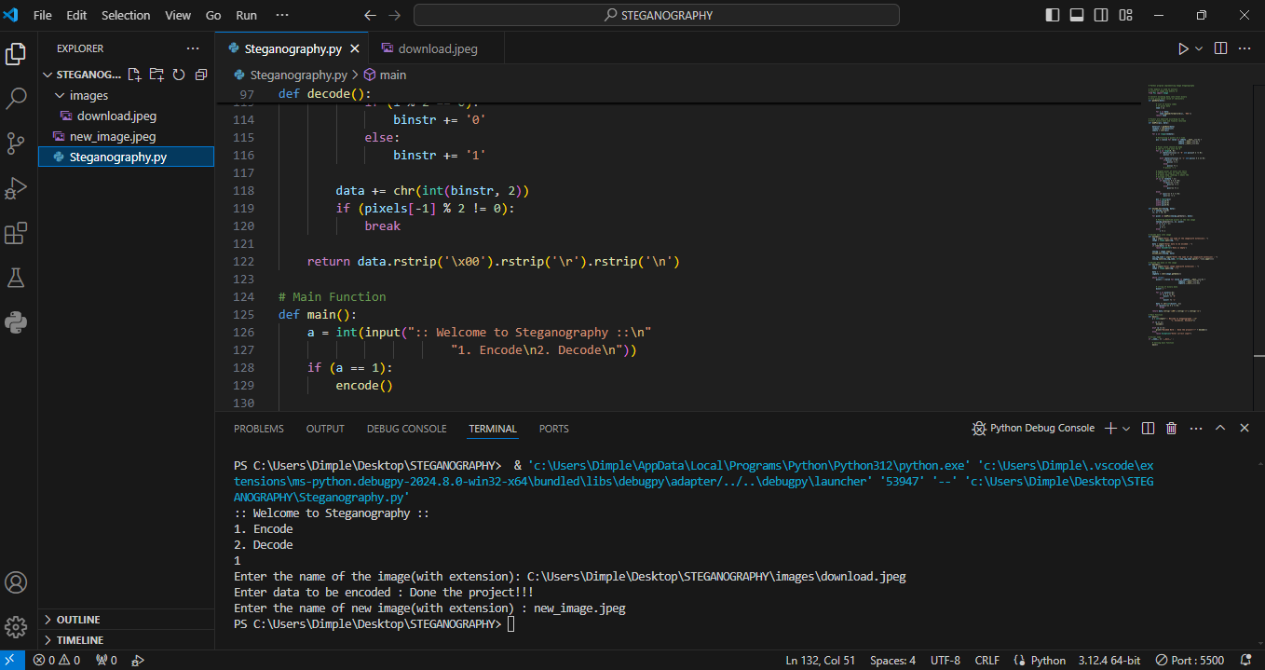
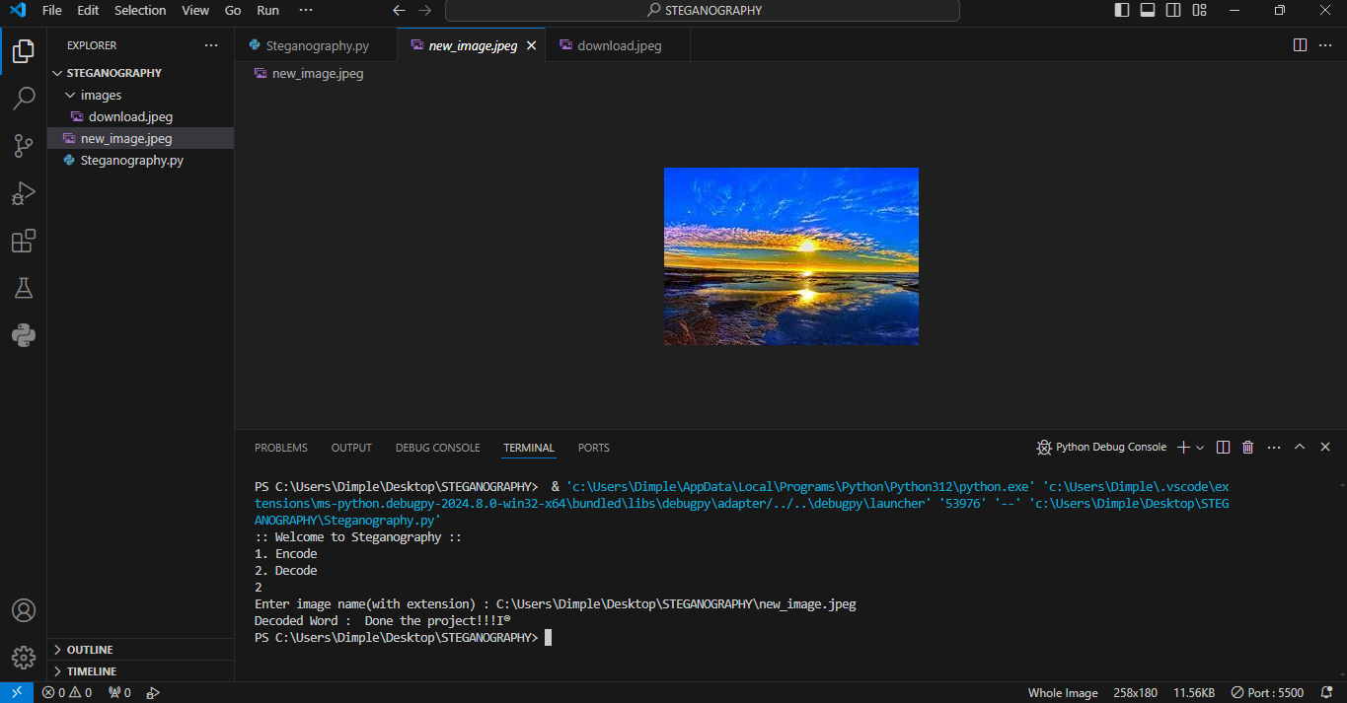
How did you customize the project and make it your own
Firstly, I have written the python code in visual studio code.
Here, I used pillow library for image manipulation.
Then, I have inserted the image and wrote the “TEXT” to be hidden in that image using secret key so that, encoded image will be formed.
The changes in the encoded image are invisible after the image was encoded by using secret key we can decode the original “TEXT”.

Slide 8
MODELLING
Encode the data :
Every byte of data is converted to its 8-bit binary code using ASCII values. Now pixels are read from left to right in a group of 3 containing a total of 9 values. The first 8-values are used to store binary data. The value is made odd if 1 occurs and even if 0 occurs.
Decode the data:
To decode, three pixels are read at a time, till the last value is odd, which means the message is over. Every 3-pixels contain a binary data, which can be extracted by the same encoding logic. If the value if odd the binary bit is 1 else 0.

Slide 9
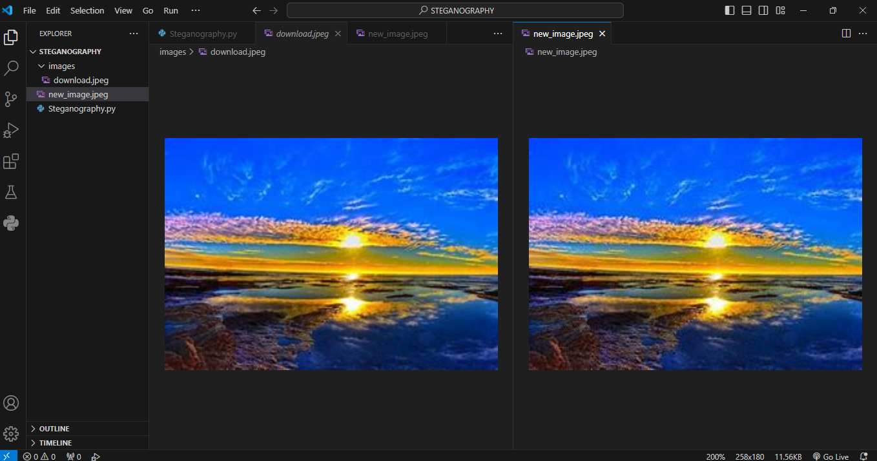
Results

Slide 10
links
https://github.com/yanagantisivani04/STEGANOGRAPHY

